Slide 1
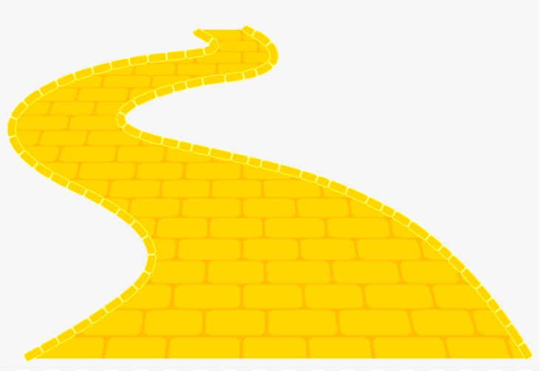
CREATING, CRITIQUING AND USING
GUIDED DISCOVERY LESSONS
Rob Gerver, Ph.D.
dr.robgerver@gmail.com
Rich Sgroi, Ph.D.
dr.rsgroi@gmail.com

Slide 2
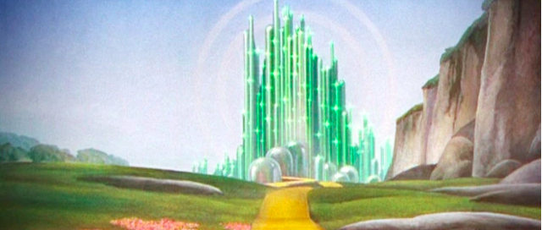
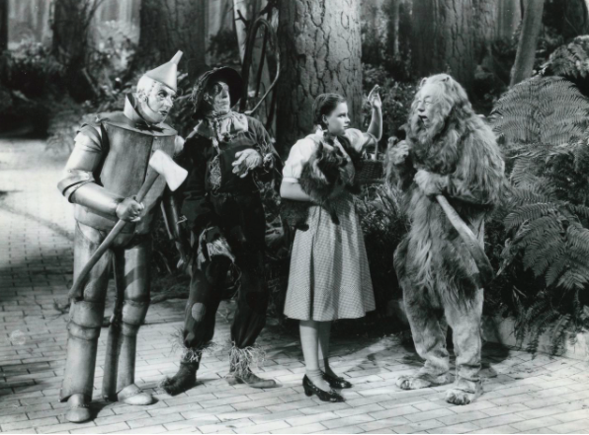
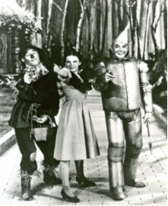
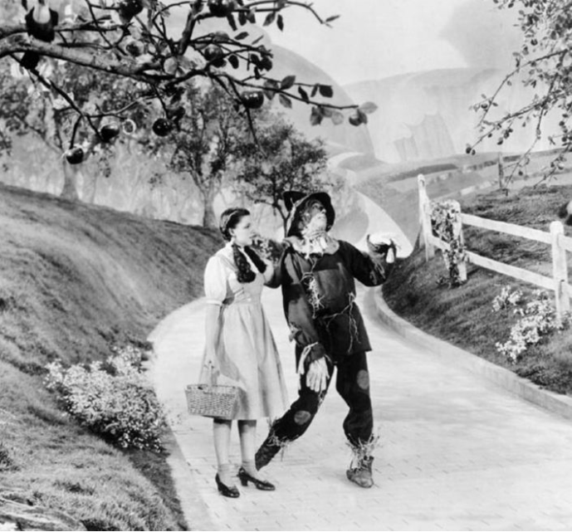
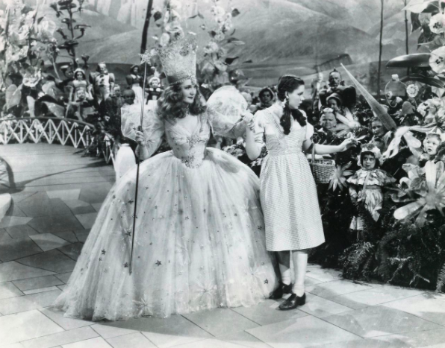
"The sum of the square roots of any two sides of an isosceles triangle is equal to the square root of the remaining side."

Slide 3
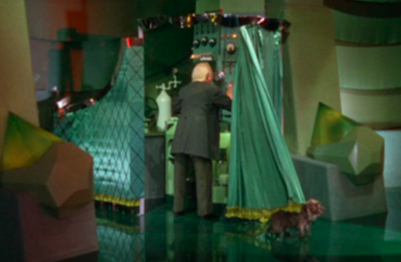
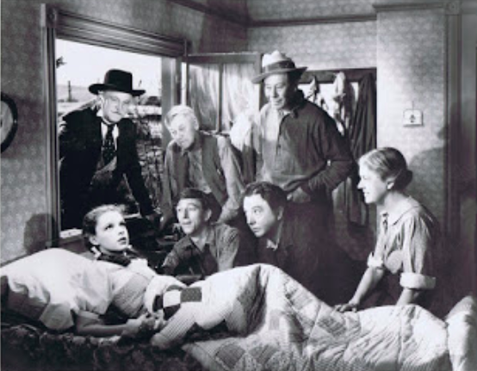
AHA!
COMPONENT

Slide 4

Comfort in Familiarity
Notes:
Start with familiar

Slide 5

Unfurling a Storyline
Notes:
Start with familiar

Slide 6









Notes:
Start with familiar

Slide 7

WHAT IS A
GUIDED DISCOVERY LESSON?
Guided-discovery lessons offer students an opportunity to become an archeologist on a mathematical dig.
Notes:
GD lessons are excellent for facilitating pattern-conjecture-proof model using repetition.
Just as it did with new readers on the elementary level, increased reading fosters better writing. Students will begin to write mathematical explanations in the style they are used to reading them.
The increased frequency of students’ running into questions they can answer increases their confidence and their ability to “fend for themselves” on some of the new assessments.
Students may actually attempt to read their textbooks since they have experienced success in deciphering new material.
“Conscience-clearing:” GD lessons vs. teacher lecture. Are you every the only one paying attention?
Students vest in GD lessons, in many cases, more so than with a lecture, since they are accountable to themselves for learning the material.

Slide 8

Notes:
Start with familiar

Slide 9
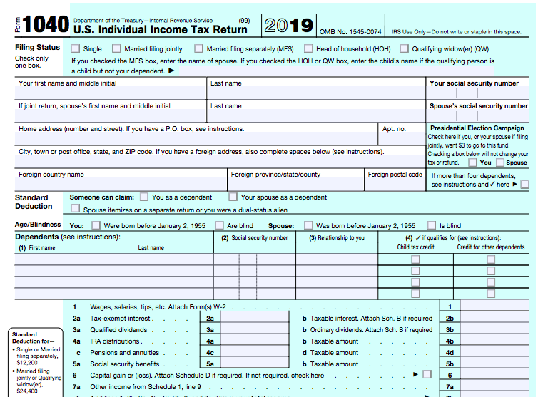
Guided, But Not Discovery!

Slide 10

Discovery, But Not Guided!

Slide 11
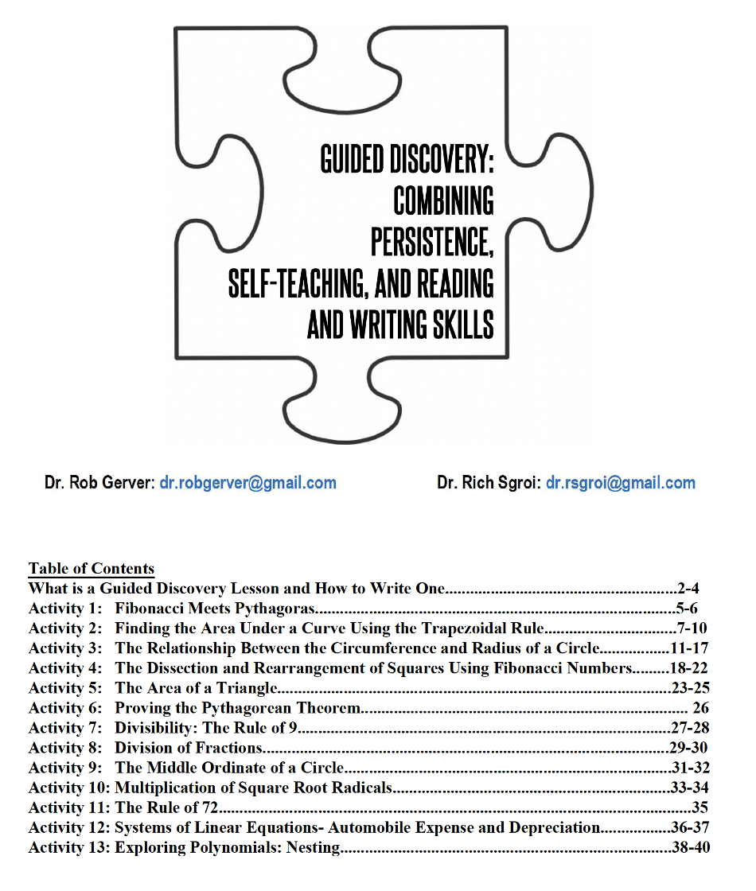
There are 13 sample Guided Discovery Activities in your online handout. They cover a range of courses and ability levels. You can access these along with today’s presentation at drrsgroi.com. Click on the Guided Discovery tab.
Notes:
14 of 21. End at 2:35.

Slide 12
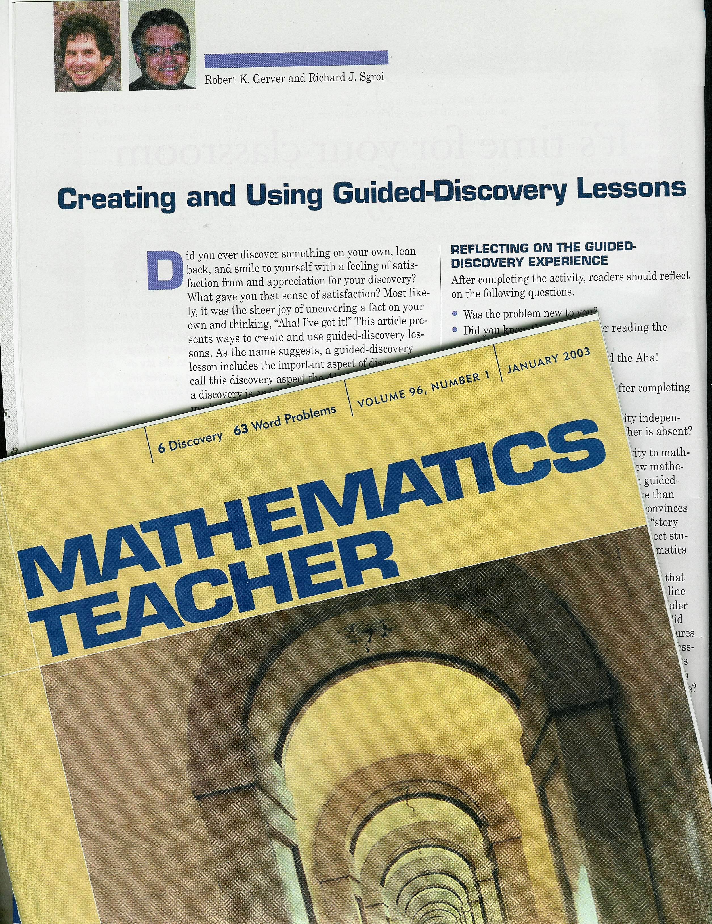

Slide 13
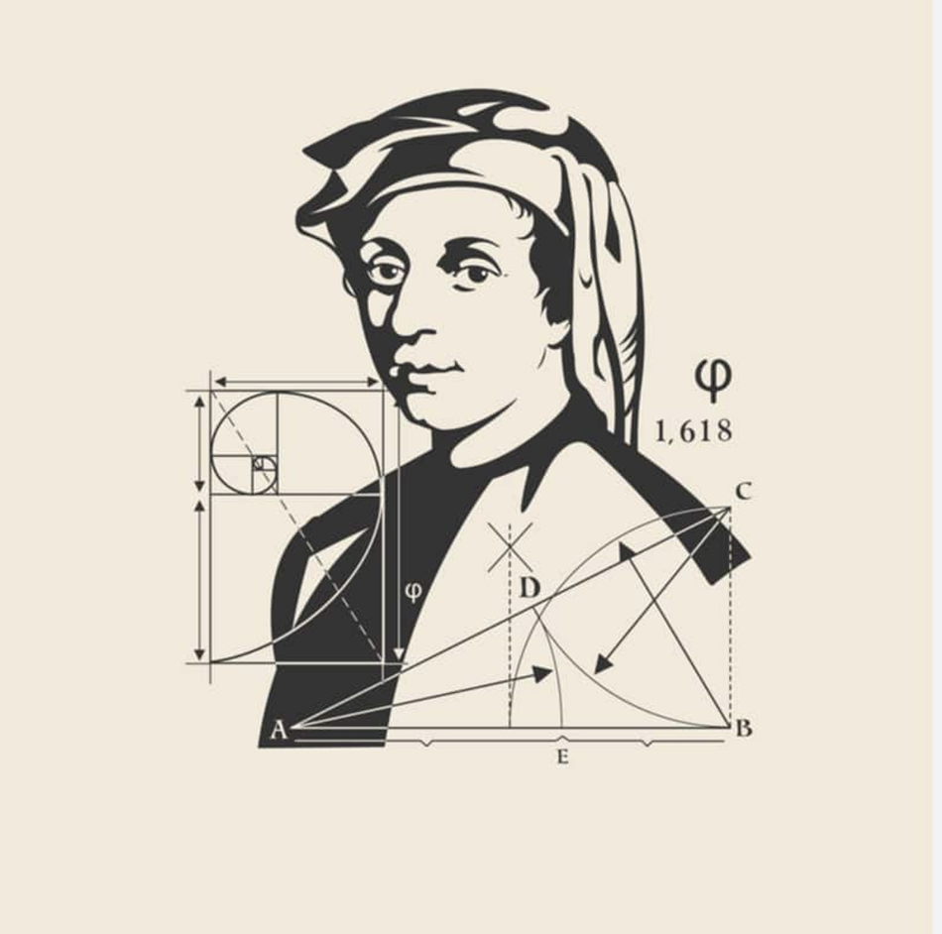
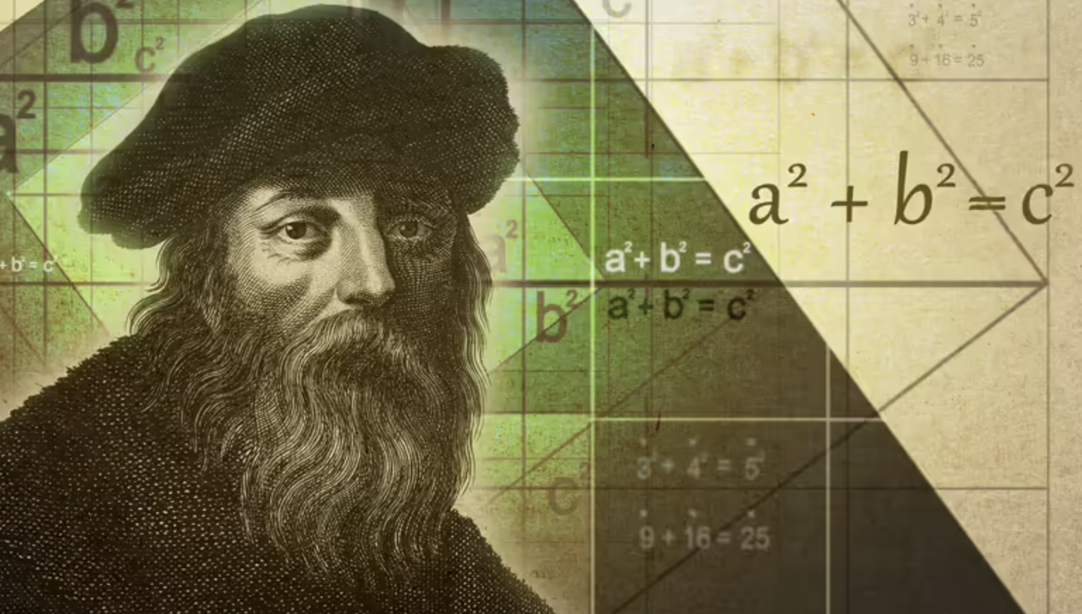
Fibonacci
&
Pythagoras

Slide 14
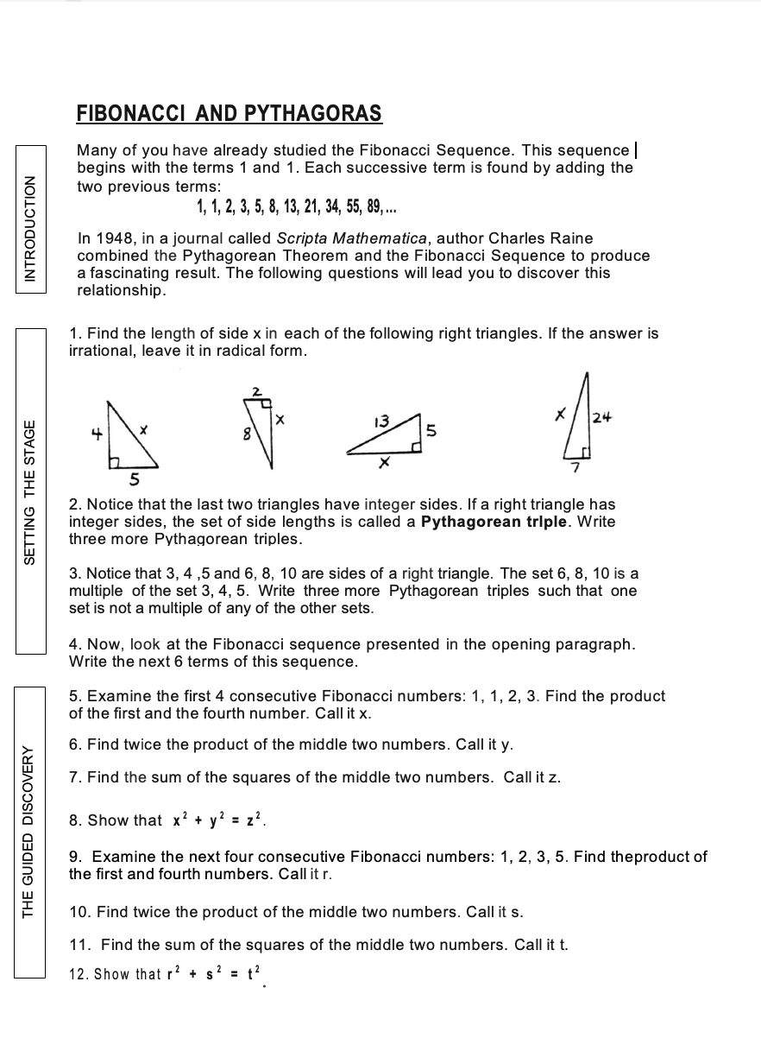
DO NOW
DO NOW
Read the “Intoduction” lines on your handout.
Scan through items 1-4 that set the stage for the activity.
Work through items 5-12. This is part of the guided discovery portion.

Slide 16
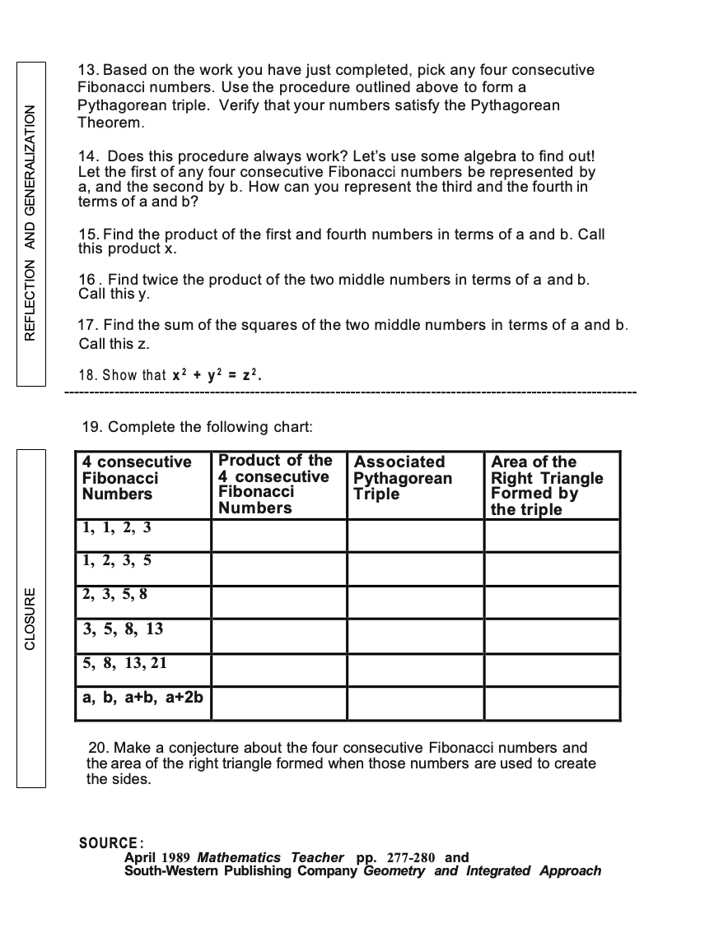

Slide 17


Slide 18
REFLECTING ON YOUR
GUIDED DISCOVERY EXPERIENCE
Was the activity new to you?
Did you have an Aha! moment? If so, where?
What understanding did you walk away with after completing this Pythagorean triples guided discovery?
What are the necessary student-learning prerequisites for this activity?
Could students complete this activity independently?
Notes:
Before hitting the points in the list, have them reflect on these questions from the article.

Slide 19
Steps for Creating and Critiquing
Guided Discovery Lessons
1. Select content
2. Identify entry conditions
3. Handle the objective
4. Outline the graduated steps
5. Write the lesson
6. Plan checkpoints
7. Naïve proofreader
8. Follow up activity to check accountability
9. Field test, critique, revise
10. Bank and share lessons
Notes:
Doing flipped at home-no control over when, where, social media, etc.

Slide 20

1. Selecting the Content
Must contain a NEW COMPONENT
Certain topics lend themselves better to guided discovery than others.
Not a review sheet activity
Recognize the difference between a guided discovery and a guided activity
Notes:
End at 2:35.

Slide 21
2. Identify the Entry Conditions
What do students need to know in order to be successful in your guided discovery lesson?
PREREQUISITES:
arithmetic
algebraic
algorithmic
geometric
graphical
symbolic
technological
Notes:
6 of 22. End 2:35.

Slide 22
3. Handling the Objective
The objective can be explicitly stated as long as it doesn’t reveal the Aha! Component.
Remember, there is no danger in being too clear. Just make sure that you don’t spoil the discovery part at the beginning of the activity.
Notes:
7 of 22. End 2:35.

Slide 23
4. Outline the Key Gradual Steps
Start with the familiar related material.
Dissect the topic into sequential, component parts.
Make a schematic outline for yourself of the basic structure of the lesson. This schematic will help in the step-by-step writing process.
Notes:
8 of 22. End 2:35.

Slide 24
Access understanding of the Pythagorean Theorem
Access understanding of the Fibonacci Sequence
Use 1,1,2,3 x=(1$∙3) y=2(1∙2) z= 1^{2}+2^{2}$
Show that x, y, z satisfy the Pythagorean relationship and form a Pythagorean triple.
Repeat above for 1, 2, 3, 5.
Develop an algebraic representation of the Fibonacci Sequence:
a, b, a + b, a + 2b.
Complete chart to relate Fibonacci quartet, product of quartet. Pythagorean Triple, and area of the right triangle.
Make conjecture about the relationship between the Fibonacci quartet and the area of a right triangle.

Slide 25
5. Write Your Lesson
Remember to be empathetic.
Be meticulous and deliberate in your design.
Use your schematic. Embellish it!
Create accessible tasks.
Differentiate for students of different ability levels.
Notes:
9 of 22. End 2:35.

Slide 26
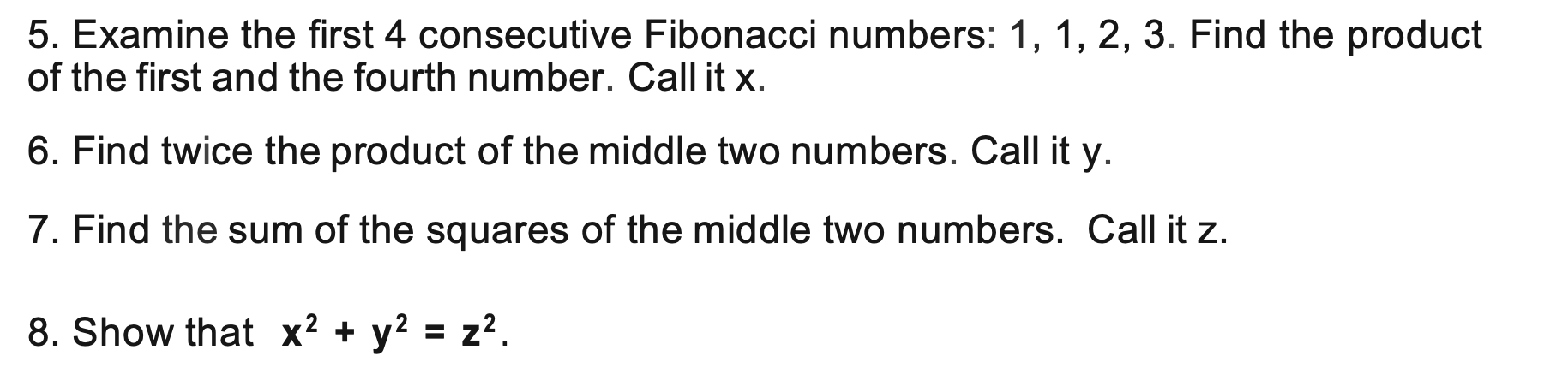
6. Plan Your Checkpoints
Teacher as roving coach.
Include a Reflection Point icon.
R
“So, what might you conclude from #8?”
Notes:
10 of 22. End 2:35.

Slide 27
7. Get a Naïve Proofreader
Uncover pitfalls, unclear directions or assumptions
Colleagues, friends, ex-students…
Independent work
Notes:
11 of 21. End at 2:35.

Slide 28
8. Write a Follow-Up Activity to Check for Accountability
Build in accountability
Cooperative groups + individual accountability
Go to
https://www.omnicalculator.com/math/fibonacci
Use this Fibonacci number generator to find 4 consecutive Fibonacci numbers beyond the 19th term. Test the conjecture you made in #20 of the activity. Show your work.
Notes:
12 of 22. End 2:35.

Slide 29
9. Field Test, Critique, and Revise
Guided Discovery lesson journal
and revise, and revise, and revise,
and revise, and revise, and revise,
and revise, and revise . . .
Notes:
13 of 22. End 2:35.

Slide 30
10. Bank and Share
Your Guided Discovery Lessons
When to use?
Join forces!!
Notes:
14 of 22. End 2:35.

Slide 31
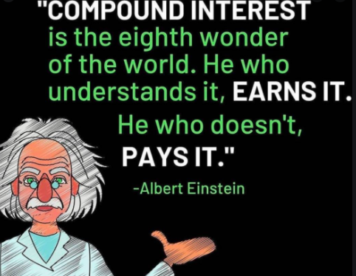
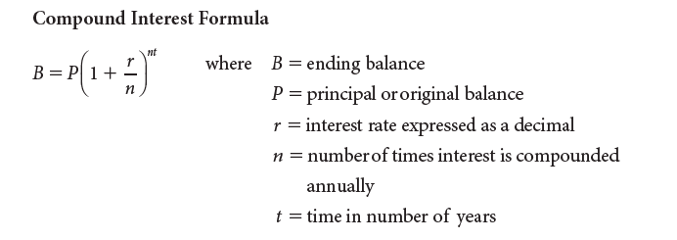
This is an excellect Guided Discovery activity that can be used when teaching about exponential equations. It is in yoiur online packet.
ALBERT EINSTEIN AND COMPOUND INTEREST
A Guided Discovery Activity
Excerpted with permission from
Financial Algebra, Gerver and Sgroi, 2021, NGL/Cengage Learning
Albert Einstein said that compound interest was “the most powerful thing
I have ever witnessed.” Work through the following exercises to discover a pattern Einstein discovered. For this activity, you will need to use the compound interest formula as stated here:
a) Suppose that you invest $2,000 at a 1% annual interest rate. Use your calculator to input different values for t in the compound interest formula. What whole number value of t will yield an amount closest to twice the initial deposit?
b) Suppose that you invest $4,000 at a 2% annual interest rate. Use your calculator to input different values for t in the compound interest formula. What whole number value of t will yield an amount closest to twice the initial deposit?

Slide 32
ALBERT EINSTEIN AND COMPOUND INTEREST
A Guided Discovery Activity
Excerpted with permission from
Financial Algebra, Gerver and Sgroi, 2021, NGL/Cengage Learning
c) Suppose that you invest $20,000 at a 6% annual interest rate. Use your calculator to input different values for t in the compound interest formula. What whole number value of t will yield an amount closest to twice the initial deposit?
d) Albert Einstein noticed a very interesting pattern when an initial deposit doubles. In each of the three examples above, multiply the value of t that you found times the percentage amount. For example, in part a, multiply t by 1. What do you notice?

Slide 33
ALBERT EINSTEIN AND COMPOUND INTEREST
A Guided Discovery Activity
Excerpted with permission from
Financial Algebra, Gerver and Sgroi, 2021, NGL/Cengage Learning
e) Einstein called this the Rule of 72 because for any initial deposit and for any interest percentage, 72 ÷ (percentage) will give you the approximate number of years it will take for the initial deposit to double in value. Einstein also said, “If people really understood the Rule of 72 they would never put their money in banks.”
Suppose that a 10-year-old has $500 to invest. She puts it in her savings account that has a 1.75% annual interest rate. How old will she be when the money doubles?

Slide 34
ALBERT EINSTEIN AND COMPOUND INTEREST
A Guided Discovery Activity
Excerpted with permission from
Financial Algebra, Gerver and Sgroi, 2021, NGL/Cengage Learning
Approximately 70 years
Approximately 35 years
Approximately 12 years
You get a number close to 72.
e) 51 years old

Slide 35
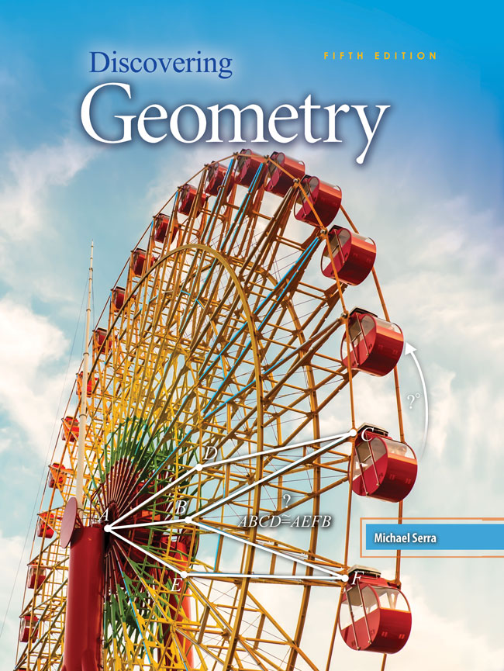
Finding Guided Discovery Lessons
Discovering Geometry by Michael Serra. Discovering Algebra by Murdock. Published by Kendall Hunt.
Out of print versions from Key Curriculum Press are available cheaply from used book sources.
Do an Internet search for guided discovery lessons—articles and examples from teacher websites.
Notes:
15 of 17. End at 2:35.

Slide 36

www.mathematicsvisionproject.org

Slide 37
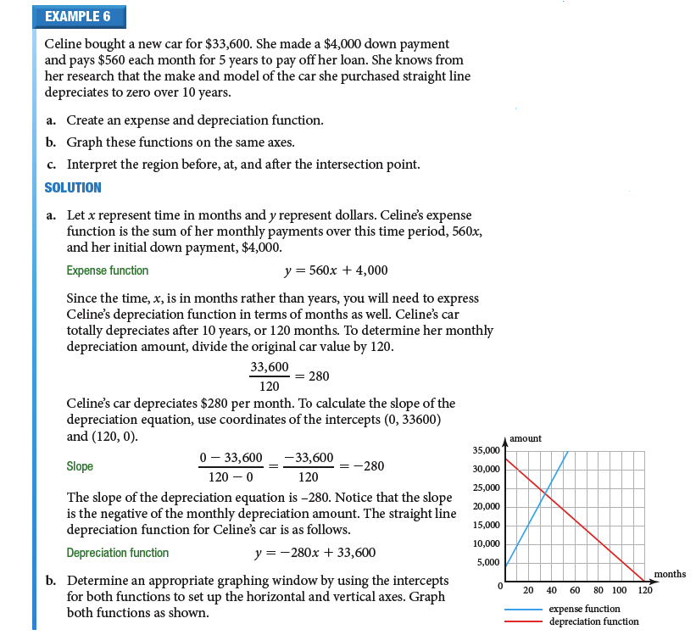
CONVERT TEXTBOOK MODEL PROBLEMS INTO GUIDED DICOVERY ACTIVITIES
Financial Algebra, Gerver and Sgroi, 2021, NGL/Cengage Learning
Used with Permission

Slide 38
Celine bought a new car for $33,600. She made a $4000 down payment and pays $560 each month for 5 years to pay off her loan. She knows from her research that the make and model of the car she purchased straight line depreciates to zero over 10 years. Write an expense and depreciation equation for this situation. Graphs this system of two equations on the same axes and interpret the results.
  Create an expense and depreciation function.
  1. What was Celine’s initial payment? _________________
  This amount represents her first investment in the car when x=0 months. This will represent the y-intercept of the expense function.
$4000
  2. How much does Celine pay per month?_______________
$560
  3. How could the ratio of the change in the total expense per month be expressed as a fraction?__________________ This will represent the slope of the expense function.
560/1
  4. Use the information from above to express the linear expense function:
  y = ____________________________
560x + 4000

Slide 39
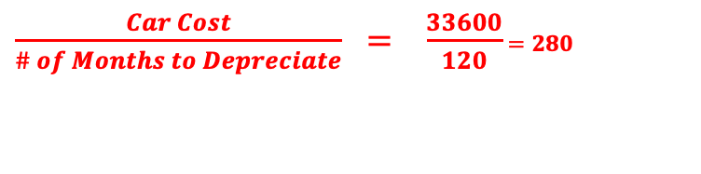
Celine bought a new car for $33,600. She made a $4000 down payment and pays $560 each month for 5 years to pay off her loan. She knows from her research that the make and model of the car she purchased straight line depreciates to zero over 10 years. Write an expense and depreciation equation for this situation. Graphs this system of two equations on the same axes and interpret the results.
5. The time x is in months rather than years. Since Celine’s car will totally depreciate after 10 years, how many months will it take for the value of this car to reach zero? _______________.
This amount will represent the x-intercept of the depreciation equation.
120
33600
6. What was the purchase price of Celine’s car? ________________
This amount will represent the y-intercept of the depreciation equation. Why?
7. What is the value of the ratio of the original car cost over the total number of months it will take for the car to depreciate? What does that value represent?
$\frac{Car Cost}{\# of Months to Depreciate} = \frac{33600}{120}$ $=280$
8. To calculate the slope of the depreciation equation, you will use the intercepts (0, 33600) and (120,0). In the context of this problem, what do these intercepts represent?
(0, 33600): When time x=0, the car has a value of $33600.
(120,0): After 120 months, the car has totally depreciated to $0.

Slide 40
Celine bought a new car for $33,600. She made a $4000 down payment and pays $560 each month for 5 years to pay off her loan. She knows from her research that the make and model of the car she purchased straight line depreciates to zero over 10 years. Write an expense and depreciation equation for this situation. Graphs this system of two equations on the same axes and interpret the results.
9. Use the coordinates of the intercepts to determine the slope of the depreciation equation?
Where have you seen that number before?
It is the monthly depreciation amount!
10. In the context of this problem, what does the slope represent? Why is it negative?
The car loses $280 per month in value. (That is why it is negative!)
y = -280x + 33600
11. Write the depreciation function. _________________

Slide 41
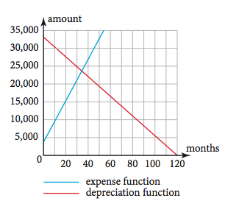
Celine bought a new car for $33,600. She made a $4000 down payment and pays $560 each month for 5 years to pay off her loan. She knows from her research that the make and model of the car she purchased straight line depreciates to zero over 10 years. Write an expense and depreciation equation for this situation. Graphs this system of two equations on the same axes and interpret the results.
12. Now, let’s take a look at the graph of this system:
The lines intersect at the point
(35.24, 23733.33). In the context of this depreciation problem, what does this point of intersection represent?
After almost 3 years (a little more than 35 months), the value of the car is equal to the car’s expense. This is called the breakeven point.
What story does the graph tell on the domain x < 35.24?
What story does the graph tell on the domain x > 35.24?
Y = 560x + 4000
Y=-280x + 33600

Slide 42
W.O.W. ! WithOut Words!
Extra Credit/Alternative Assessment or a Guided Discovery lesson you can write on your own.
The students do not work from guided questions—they are working with nothing but a picture or table and what they want to show.
Notes:
End at 2:35.

Slide 43
WithOut Words: Give Quadratics and Have Students Make Conjecture Based on Table
Quadratic Equation | a | b | c | Roots | Sum of the Roots | -b/a | Product of the Roots | c/a
x² - 5x + 6 = 0
x² - 8x + 15 = 0
x² + 7x + 12 = 0
x² - 7x - 8 = 0
X² - 6x + 8 = 0
x² + 10x + 25 = 0
x² - 49 = 0
x² + 5x +6 = 0
x² + 2x - 3 = 0
Notes:
End at 2:35.

Slide 44
WithOut Words: Give Quadratics and Have Students Make Conjecture Based on Table
Quadratic Equation | a | b | c | Roots | Sum of the Roots | -b/a | Product of the Roots | c/a
x² - 5x + 6 = 0 | 1 | -5 | 6 | 2, 3 | 5 | 5 | 6 | 6
x² - 8x + 15 = 0 | 1 | -8 | 15 | 3, 5 | 8 | 8 | 15 | 15
x² + 7x + 12 = 0 | 1 | 7 | 12 | -3, -4 | -7 | -7 | 12 | 12
x² - 7x - 8 = 0 | 1 | -7 | -8 | -1, 8 | 7 | 7 | -8 | -8
x² - 6x + 8 = 0 | 1 | -6 | 8 | 2, 4 | 6 | 6 | 8 | 8
x² + 10x + 25 = 0 | 1 | 10 | 25 | 5, 5 | 10 | 10 | 25 | 25
x² - 49 = 0 | 1 | 0 | -49 | 7, -7 | 0 | 0 | -49 | -49
x² + 5x +6 = 0 | 1 | 5 | 6 | -2, -3 | -5 | -5 | 6 | 6
x² + 2x - 3 = 0 | 1 | 2 | -3 | -1, 3 | 2 | 2 | -3 | -3
Notes:
End at 2:35.

Slide 45
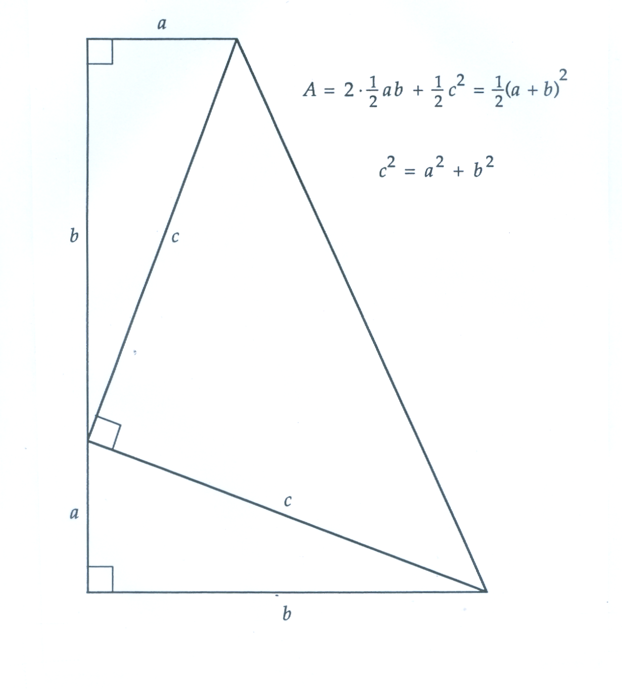
WithOut Words:
Excellent discovery activities, with or without verbal/algebraic hints! Great extra credit, take-home test bonus, etc.
Notes:
End at 2:35.

Slide 46
You Can Make the WithOut Words Exercises into Your Own Guided Discovery Lessons!
A right triangle has legs a and b and hypotenuse c. We are going to look at a relationship between these three sides that holds for all right triangles.
1. A right triangle has legs 4 and 17. Find the area of the triangle.____________
2. A triangle has legs a and b. Express the area of the triangle in terms of a and b. ____________
3. In the picture on the right, find the area of
right triangle I. _____________
4. Find the area of right triangle II.______________
5. Find the area of right triangle III.___________
6. Eliminate the sides with length c in the picture. Since the quadrilateral has only one pair of parallel sides, the quadrilateral is a _________________.
7. To find the area of the quadrilateral, you can add the area of the three right triangles. Combine like terms and express this area in simplest form.
________________________________________

Slide 47
You Can Make the WithOut Words Exercises into Your Own Guided Discovery Lessons!
8. Express the measure of the height of the trapezoid on the right in terms of a and b._____________
9. What is the length of the larger base of the trapezoid?_______
10. What is the length of the smaller base of the trapezoid?______________
11. What is the area of the trapezoid expressed in terms of a and b?________________________________
12. Square the binomial (a + b) in your expression from question 11, and rewrite your answer to question 11 with the trinomial you found after multiplying (a + b) by (a + b).
___________________________________________
13. In question 7 above, you found the area of the same trapezoid by adding the areas of the three right triangles. Set that expression equal to your answer from question 12.
__________________________________
14. Multiply both sides of the equation by 2 to eliminate the fraction.
_______________________________________________________
15. Subtract 2ab from both sides. What is the new equation?______________________

Slide 48


Don’t Re-Invent the Wheel!
“Proofs Without Words” by Roger Nelsen
MAA.org
Notes:
End at 2:35.

Slide 49
Don’t Lose a Day!
Guided discovery lessons are perfect to have students move ahead even on days you are absent and have a non-math substitute!
Notes:
21 of 22. End at 2:35.

Slide 50
Thank You
for attending this session!
If you have any questions or comments, please feel free to contact Rob or Rich:
dr.rsgroi@gmail.com
dr.robgerver@gmail.com

