Slide 1

USING AND CREATING
GUIDED DISCOVERY ACTIVITIES
Rich Sgroi, Ph.D.
dr.rsgroi@gmail.com
While you are waiting, please start the Guided Discovery Do Now on your handout.

Slide 2

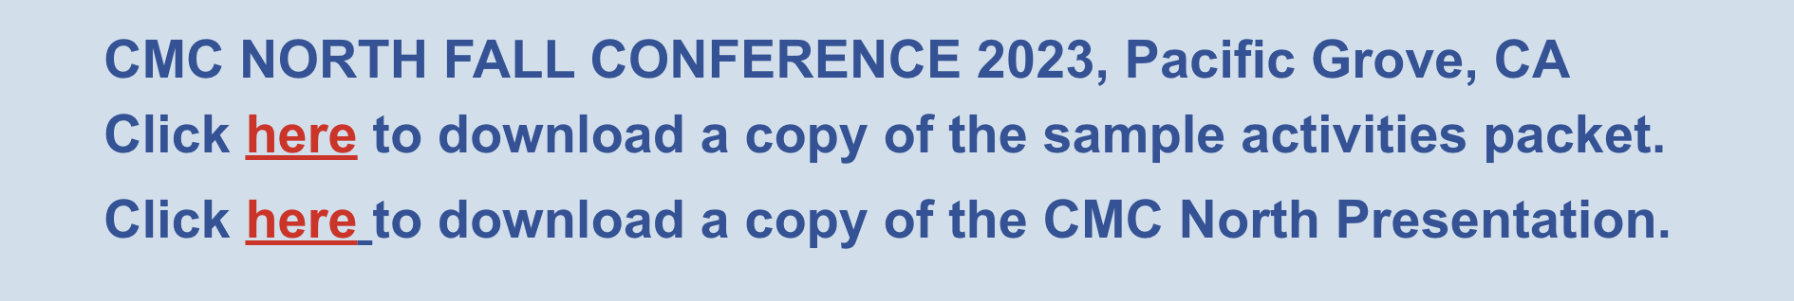

Slide 3
CHOCOLATE MATH
Let C = the chocolate number.
Multiply that number by 2. 2C
Add 5. 2C + 5
Multiply by 50. 50(2C + 5) = 100C + 250

Slide 4
CHOCOLATE MATH
11a. If you already had your birthday this year, add 1773.
100C + 250 + 1773 = 100C + 2023
11b. If you haven’t had your birthday this year, add 1772.
100C + 250 + 1772 = 100C + 2022
Subtract the 4-digit year you were born. In both cases, you get 100C + YOUR AGE

Slide 5
CHOCOLATE MATH
100C + YOUR AGE
Suppose your 2-digit age is AB, then the expression is 100C + AB.
100C + AB is the 3-digit number CAB.
CAB
chocolate number your age

Slide 6
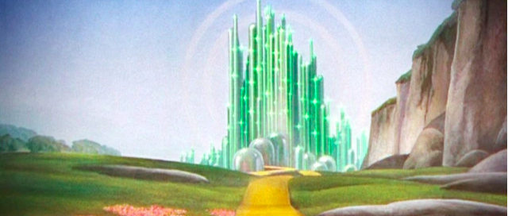
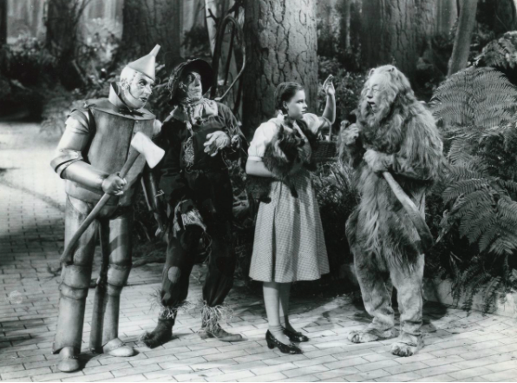
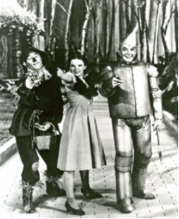
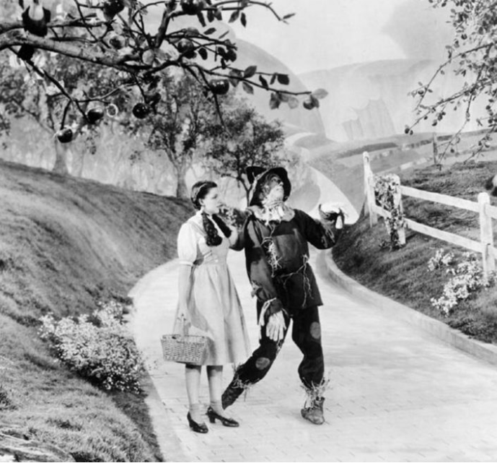
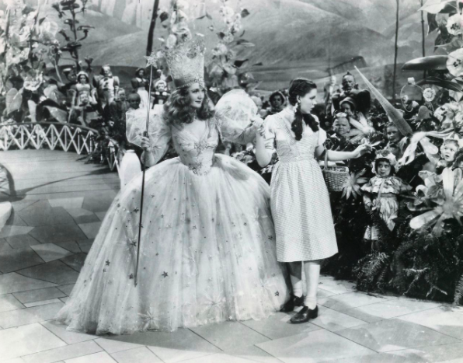
"The sum of the square roots of any two sides of an isosceles triangle is equal to the square root of the remaining side."
*

Slide 7

Unfurling a Storyline

Slide 8
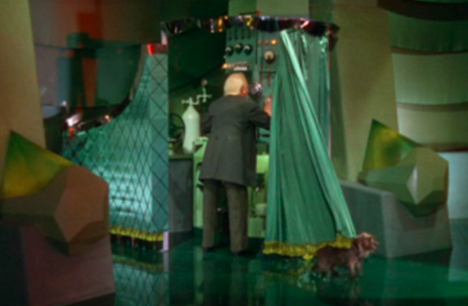
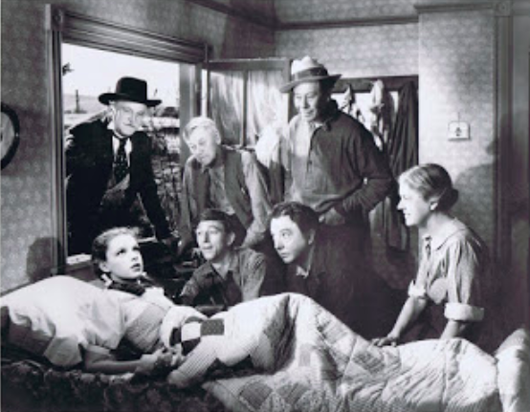
AHA!
COMPONENT
*

Slide 9









*

Slide 10

WHAT IS A
GUIDED DISCOVERY LESSON?
Guided-discovery lessons offer students an opportunity to become an archeologist on a mathematical dig.

Slide 11
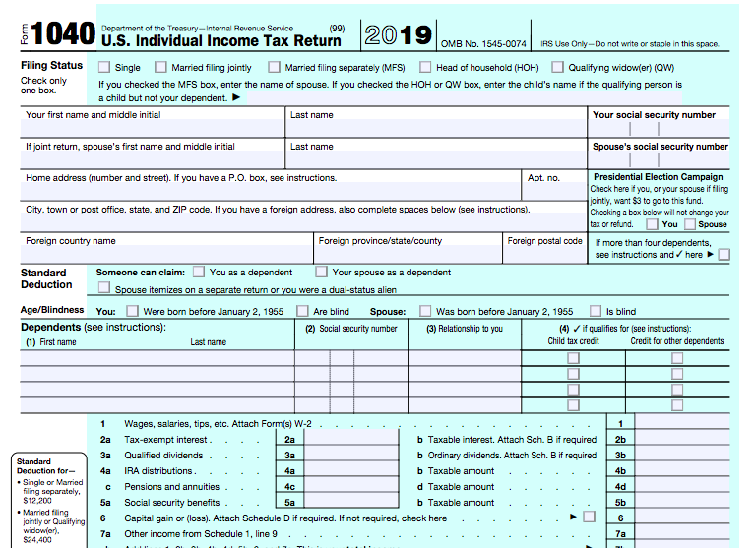
Guided, But Not Discovery!

Slide 12

Discovery, But Not Guided!

Slide 13
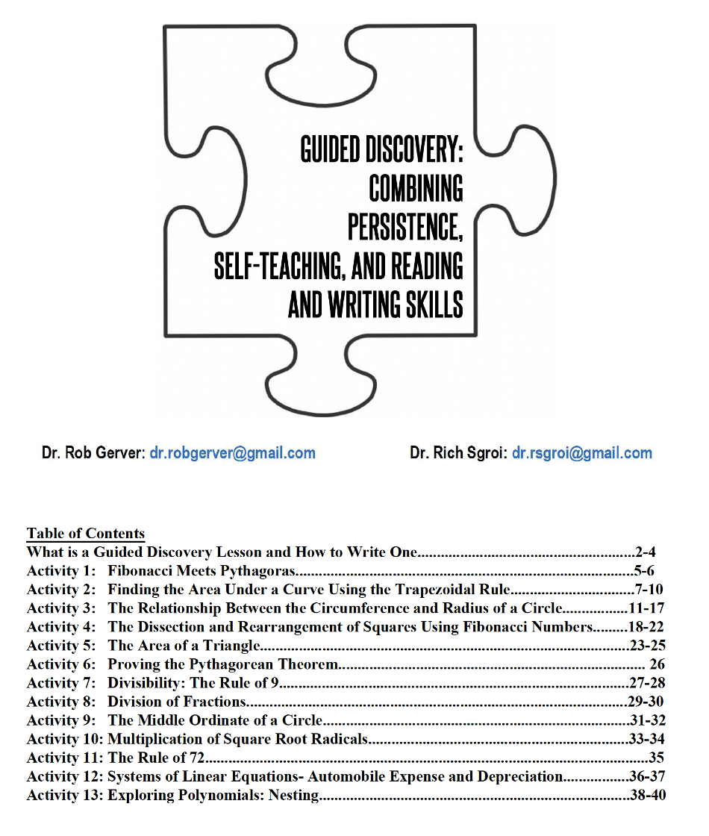
There are 13 sample Guided Discovery Activities in your online handout. They cover a range of courses and ability levels. You can access these along with today’s presentation at drrsgroi.com. Click on the Guided Discovery tab.
*

Slide 14
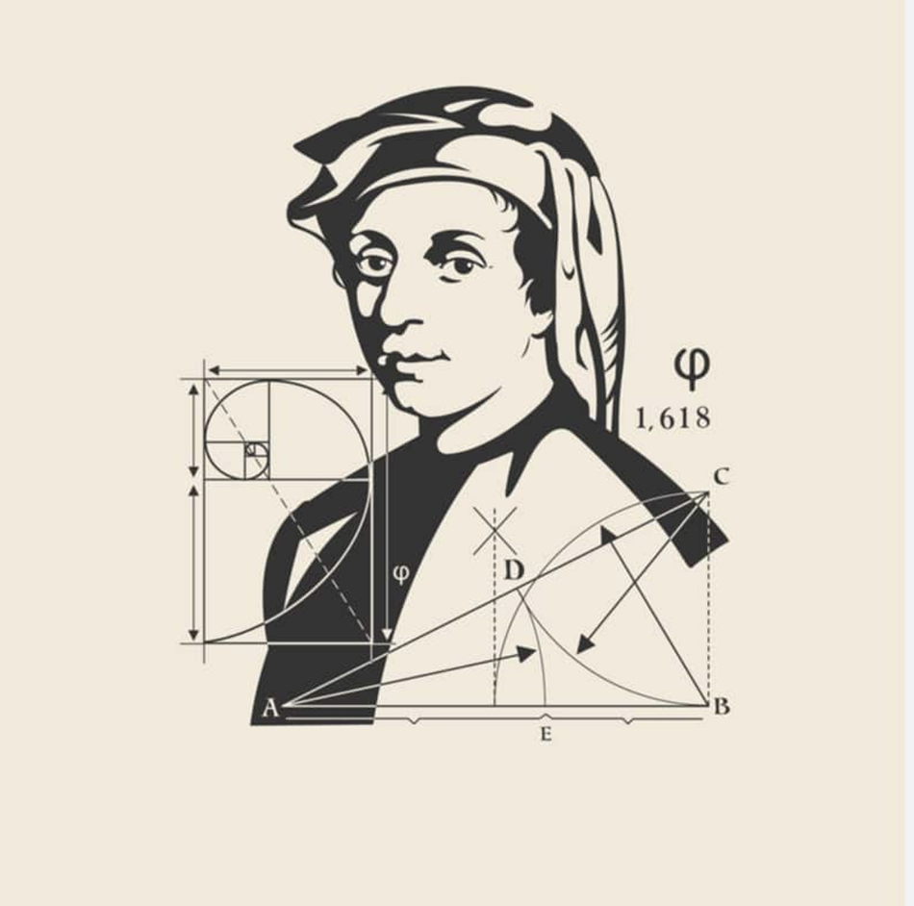
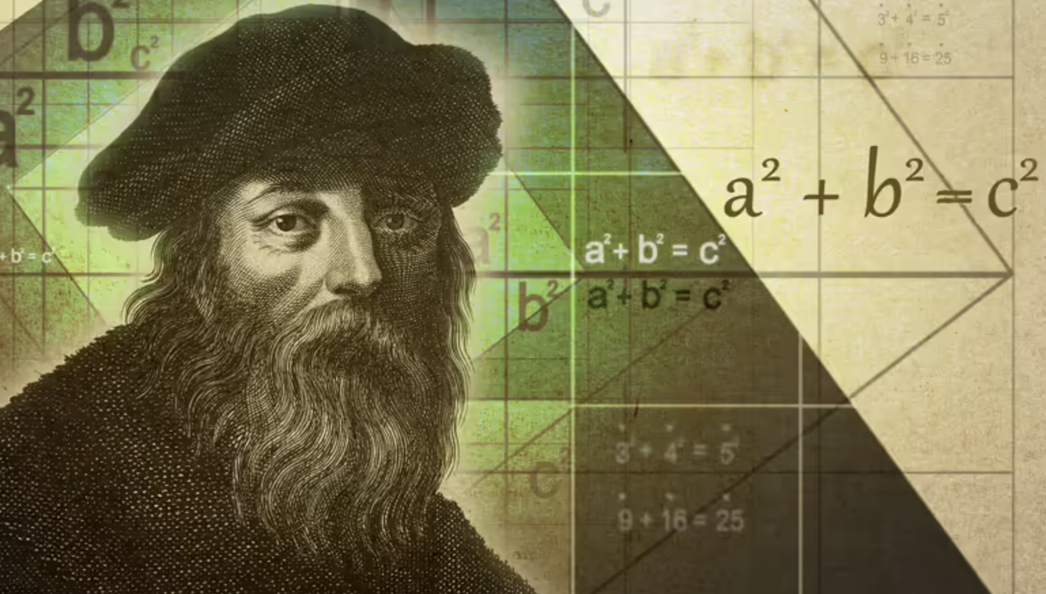
Fibonacci
&
Pythagoras

Slide 15
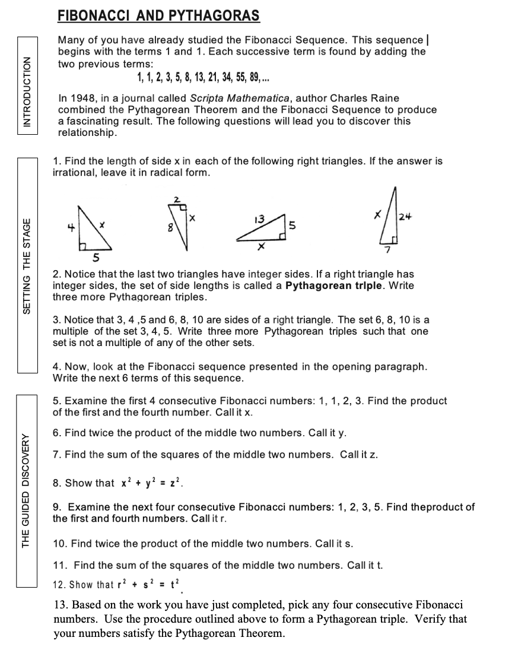
DO NOW
Read the “Intoduction” lines on your handout.
Scan through items 1-4 that set the stage for the activity.
Work through items 5-13. This is part of the guided discovery portion.
DO NOW
*

Slide 16
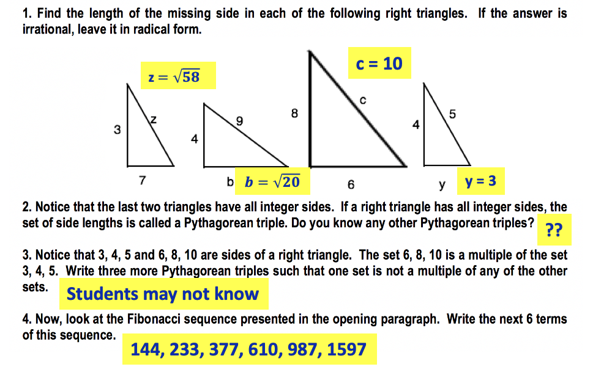
Solutions 1 - 4

Slide 17
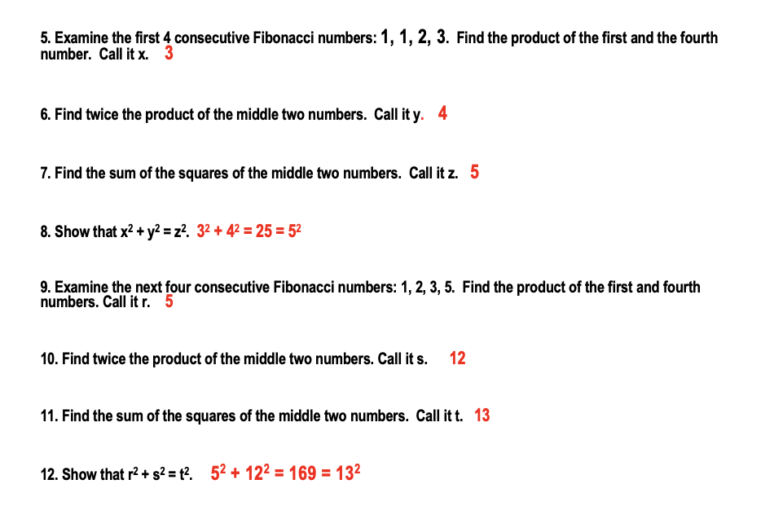
Solutions 5 - 12

Slide 18
REFLECTING ON YOUR GUIDED DISCOVERY EXPERIENCE
Was the activity new to you?
Did you have an Aha! moment? If so, where?
What understanding did you walk away with after completing this Pythagorean triples guided discovery?
What are the necessary student-learning prerequisites for this activity?
Could students complete this activity independently?
*

Slide 19
Solutions 14 - 18
Does this procedure always work? Let the first of any four consecutive Fibonacci numbers be represented by a, and the second by b. How can you represent the third and the fourth in terms of a and b?
a, b, a+b, a+2b
15. Find the product of the first and fourth numbers in terms of a and b. Call this product x.
a² + 2ab
16. Find twice the product of the two middle numbers in terms of a and b. Call this y.
2ab + 2b²
17. Find the sum of the squares of the two middle numbers in terms of a and b. Call this z.
b² + a² + 2ab + b² = a² + 2ab + 2b²
Show that x² + y² = z².
(a² + 2ab)² + (2ab + 2b²)² = (a² + 2ab + 2b² )²
a⁴ + 4a³b + 8a²b² + 8ab³ + 4b⁴ = a⁴ + 4a³b + 8a²b² + 8ab³ + 4b⁴ ✓

Slide 20
Another Aha!! 19 - 20
19. Use the process you just discovered on the different sets of four consecutive Fibonacci numbers to complete the table.
20. Make a conjecture about the four consecutive Fibonacci numbers and the area of the right triangle formed when those numbers are used to create the sides.
4 CONSECUTIVE FIBONACCI NUMBERS | PRODUCT OF THE 4 CONSECUTIVE FIBONACCI NUMBERS | ASSOCIATED PYTHAGOREAN TRIPLE | AREA OF THE RIGHT TRIANGLE FORMED BY THE TRIPLE
1, 1, 2, 3
1, 2, 3, 5
2, 3, 5, 8
3, 5, 8, 13
5, 8, 13, 21
a, b, a+b, a+2b

Slide 21
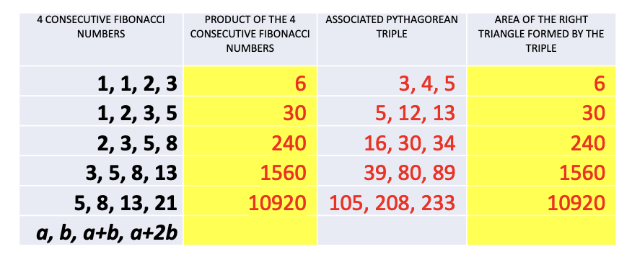
Another Aha!! 19 - 20
19. Use the process you just discovered on the different sets of four consecutive Fibonacci numbers to complete the table.
20. Make a conjecture about the four consecutive Fibonacci numbers and the area of the right triangle formed when those numbers are used to create the sides.
4 CONSECUTIVE FIBONACCI NUMBERS | PRODUCT OF THE 4 CONSECUTIVE FIBONACCI NUMBERS | ASSOCIATED PYTHAGOREAN TRIPLE | AREA OF THE RIGHT TRIANGLE FORMED BY THE TRIPLE
1, 1, 2, 3
1, 2, 3, 5
2, 3, 5, 8
3, 5, 8, 13
5, 8, 13, 21
a, b, a+b, a+2b

Slide 22
Steps for Creating and Critiquing
Guided Discovery Lessons
1. Select content
2. Identify entry conditions
3. Handle the objective
4. Outline the graduated steps
5. Write the lesson
6. Plan checkpoints
7. Naïve proofreader
8. Follow up activity to check accountability
9. Field test, critique, revise
10. Bank and share lessons

Slide 23

1. Selecting the Content
Must contain a NEW COMPONENT
Certain topics lend themselves better to guided discovery than others.
Not a review sheet activity
Recognize the difference between a guided discovery and a guided activity
*

Slide 24
2. Identify the Entry Conditions
What do students need to know in order to be successful in your guided discovery lesson?
PREREQUISITES:
arithmetic
algebraic
algorithmic
geometric
graphical
symbolic
technological

Slide 25
3. Handling the Objective
The objective can be explicitly stated as long as it doesn’t reveal the Aha! Component.
Remember, there is no danger in being too clear. Just make sure that you don’t spoil the discovery part at the beginning of the activity.
*

Slide 26
4. Outline the Key Gradual Steps
Start with the familiar related material.
Dissect the topic into sequential, component parts.
Make a schematic outline for yourself of the basic structure of the lesson. This schematic will help in the step-by-step writing process.

Slide 27

Access understanding of the Pythagorean Theorem
Access understanding of the Fibonacci Sequence
Use 1,1,2,3 x=(1$∙3) y=2(1∙2) z= 1^{2}+2^{2}$
Show that x, y, z satisfy the Pythagorean relationship and form a Pythagorean triple.
Repeat above for 1, 2, 3, 5.
Develop an algebraic representation of the Fibonacci Sequence:
a, b, a + b, a + 2b.
Complete chart to relate Fibonacci quartet, product of quartet. Pythagorean Triple, and area of the right triangle.
Make conjecture about the relationship between the Fibonacci quartet and the area of a right triangle.
*

Slide 28
5. Write Your Lesson
Remember to be empathetic.
Be meticulous and deliberate in your design.
Use your schematic. Embellish it!
Create accessible tasks.
Differentiate for students of different ability levels.

Slide 29
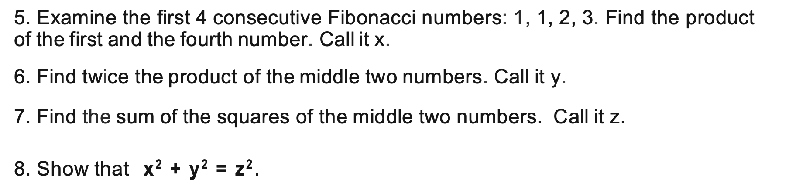
6. Plan Your Checkpoints
Teacher as roving coach.
Include a Reflection Point icon.
R
“So, what might you conclude from #8?”
*

Slide 30
7. Get a Naïve Proofreader
Uncover pitfalls, unclear directions or assumptions
Colleagues, friends, ex-students…
Independent work

Slide 31
8. Write a Follow-Up Activity to Check for Accountability
Build in accountability
Cooperative groups + individual accountability
Go to
https://www.omnicalculator.com/math/fibonacci
Use this Fibonacci number generator to find 4 consecutive Fibonacci numbers beyond the 19th term. Test the conjecture you made in #20 of the activity. Show your work.
*

Slide 32
9. Field Test, Critique, and Revise
Guided Discovery lesson journal
and revise, and revise, and revise,
and revise, and revise, and revise,
and revise, and revise . . .

Slide 33
10. Bank and Share
Your Guided Discovery Lessons
When to use?
Join forces!!

Slide 34
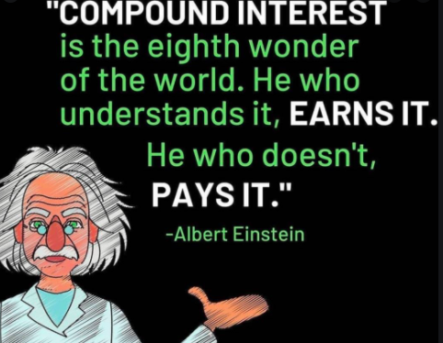
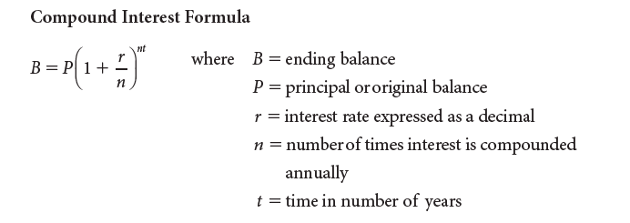
This is an excellect Guided Discovery activity that can be used when teaching about exponential equations. It is in yoiur online packet.
ALBERT EINSTEIN AND COMPOUND INTEREST
A Guided Discovery Activity
Excerpted with permission from
Financial Algebra, Gerver and Sgroi, 2021, NGL/Cengage Learning
Albert Einstein said that compound interest was “the most powerful thing
I have ever witnessed.” Work through the following exercises to discover a pattern Einstein discovered. For this activity, you will need to use the compound interest formula as stated here:
a) Suppose that you invest $2,000 at a 1% annual interest rate. Use your calculator to input different values for t in the compound interest formula. What whole number value of t will yield an amount closest to twice the initial deposit?
b) Suppose that you invest $4,000 at a 2% annual interest rate. Use your calculator to input different values for t in the compound interest formula. What whole number value of t will yield an amount closest to twice the initial deposit?
*

Slide 35
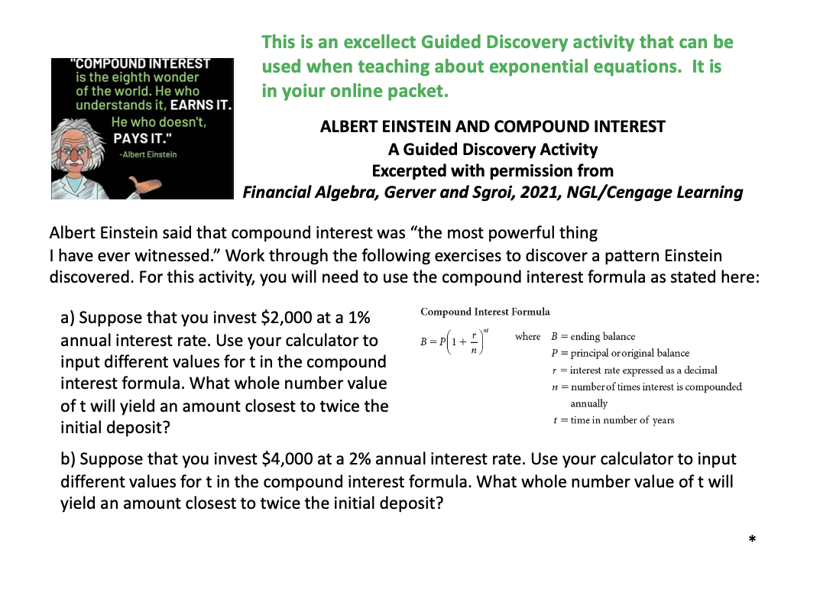

Slide 36
ALBERT EINSTEIN AND COMPOUND INTEREST
A Guided Discovery Activity
Excerpted with permission from
Financial Algebra, Gerver and Sgroi, 2021, NGL/Cengage Learning
c) Suppose that you invest $20,000 at a 6% annual interest rate. Use your calculator to input different values for t in the compound interest formula. What whole number value of t will yield an amount closest to twice the initial deposit?
d) Albert Einstein noticed a very interesting pattern when an initial deposit doubles. In each of the three examples above, multiply the value of t that you found times the percentage amount. For example, in part a, multiply t by 1. What do you notice?
*

Slide 37
ALBERT EINSTEIN AND COMPOUND INTEREST
A Guided Discovery Activity
Excerpted with permission from
Financial Algebra, Gerver and Sgroi, 2021, NGL/Cengage Learning
e) Einstein called this the Rule of 72 because for any initial deposit and for any interest percentage, 72 ÷ (percentage) will give you the approximate number of years it will take for the initial deposit to double in value. Einstein also said, “If people really understood the Rule of 72 they would never put their money in banks.”
Suppose that a 10-year-old has $500 to invest. She puts it in her savings account that has a 1.75% annual interest rate. How old will she be when the money doubles?
*

Slide 38
ALBERT EINSTEIN AND COMPOUND INTEREST
A Guided Discovery Activity
Excerpted with permission from
Financial Algebra, Gerver and Sgroi, 2021, NGL/Cengage Learning
Approximately 70 years
Approximately 35 years
Approximately 12 years
You get a number close to 72.
e) 51 years old
*

Slide 39
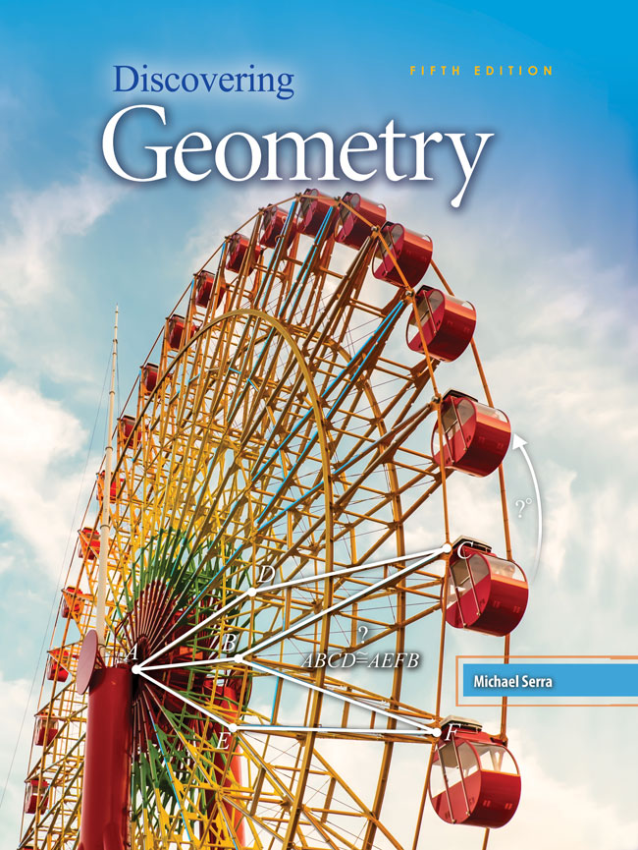
Finding Guided Discovery Lessons
Discovering Geometry by Michael Serra. Discovering Algebra by Murdock. Published by Kendall Hunt.
Out of print versions from Key Curriculum Press are available cheaply from used book sources.
Do an Internet search for guided discovery lessons—articles and examples from teacher websites.

Slide 40

www.mathematicsvisionproject.org

Slide 41
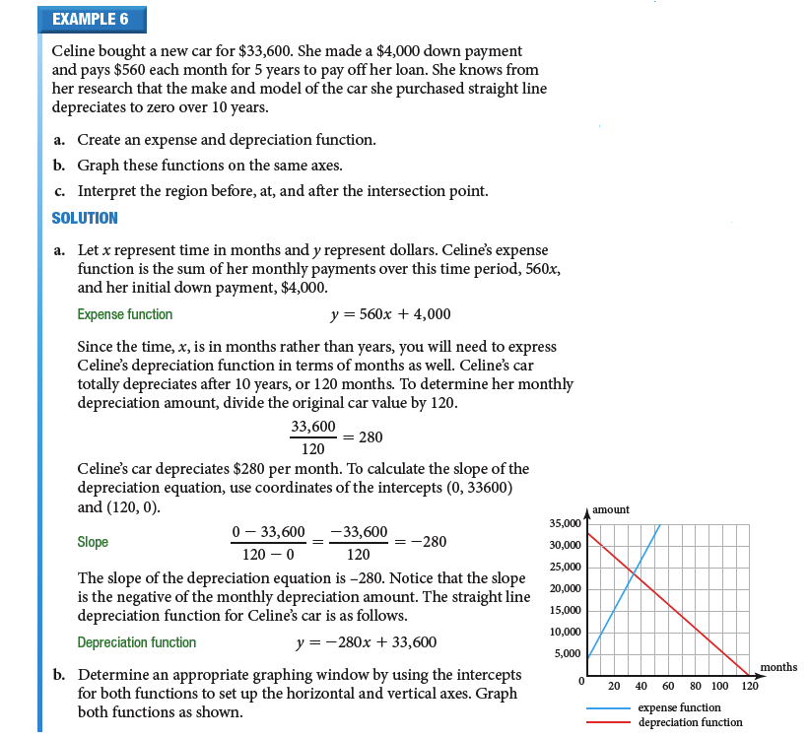
CONVERT TEXTBOOK MODEL PROBLEMS INTO GUIDED DICOVERY ACTIVITIES
Financial Algebra, Gerver and Sgroi, 2021, NGL/Cengage Learning
Used with Permission
*

Slide 42
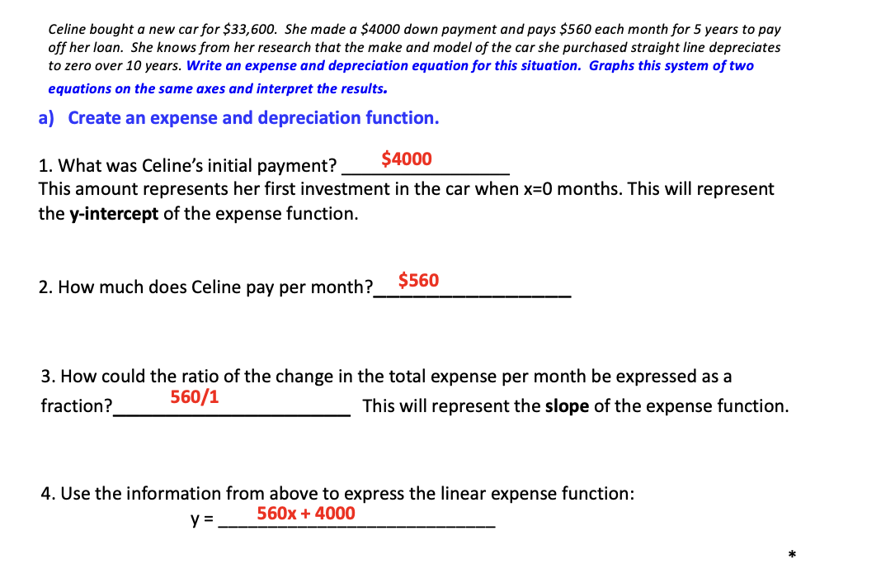
*

Slide 43
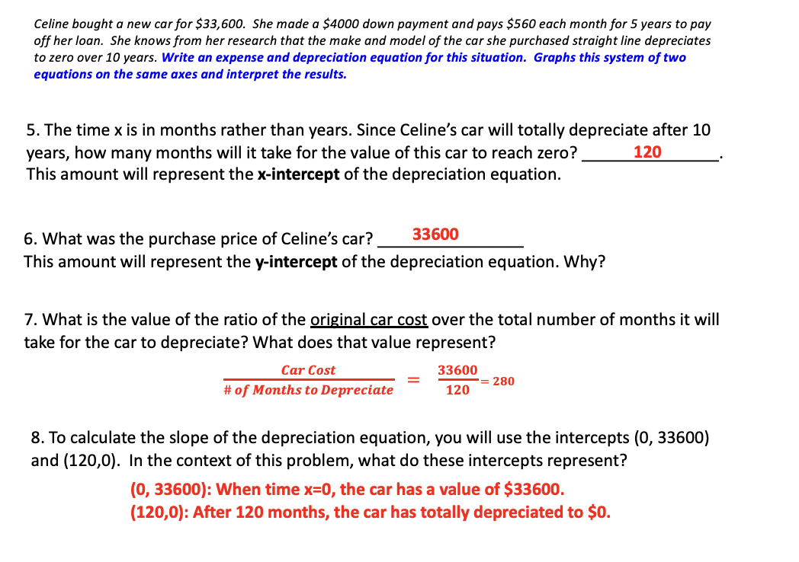

Slide 44
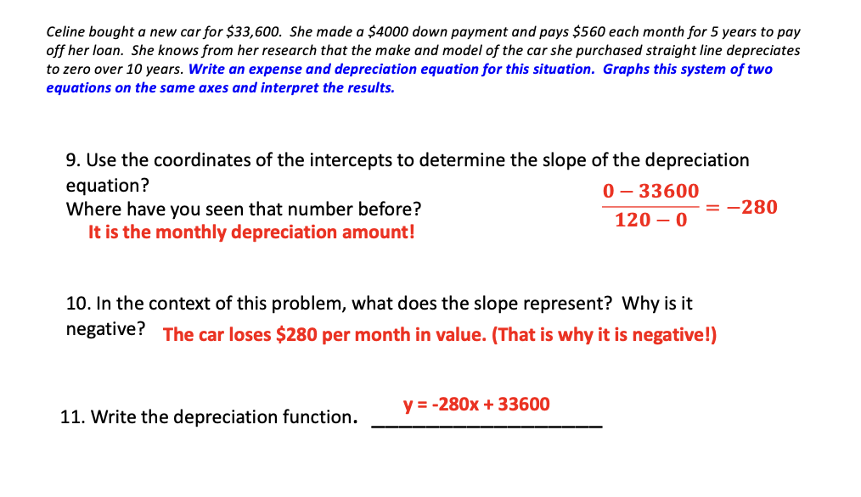

Slide 45
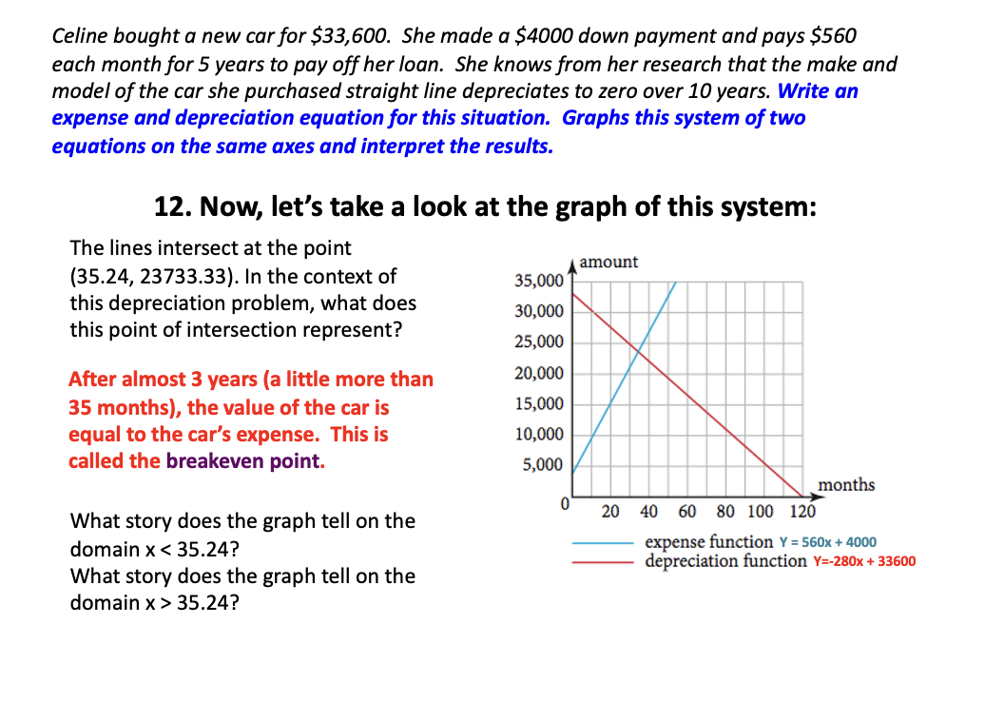

Slide 46
W.O.W. ! WithOut Words!
Extra Credit/Alternative Assessment or a Guided Discovery lesson you can write on your own.
The students do not work from guided questions—they are working with nothing but a picture or table and what they want to show.

Slide 47
WithOut Words: Give Quadratics and Have Students Make Conjecture Based on Table
Quadratic Equation | a | b | c | Roots | Sum of the Roots | -b/a | Product of the Roots | c/a
x² - 5x + 6 = 0
x² - 8x + 15 = 0
x² + 7x + 12 = 0
x² - 7x - 8 = 0
X² - 6x + 8 = 0
x² + 10x + 25 = 0
x² - 49 = 0
x² + 5x +6 = 0
x² + 2x - 3 = 0

Slide 48
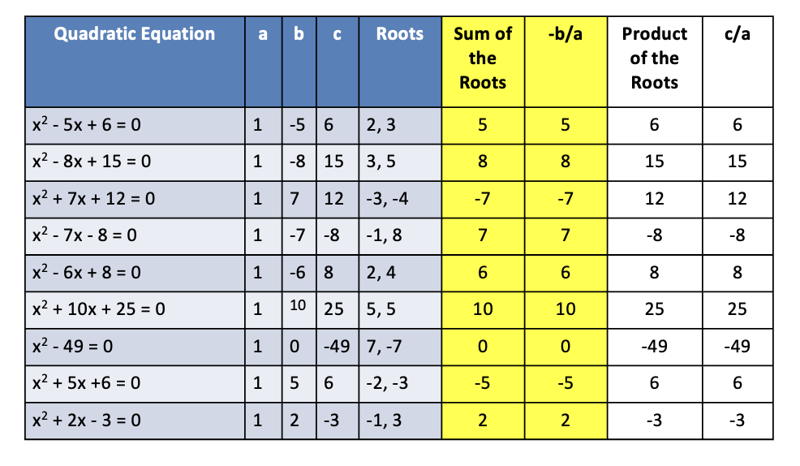
WithOut Words: Give Quadratics and Have Students Make Conjecture Based on Table
Quadratic Equation | a | b | c | Roots | Sum of the Roots | -b/a | Product of the Roots | c/a
x² - 5x + 6 = 0
x² - 8x + 15 = 0
x² + 7x + 12 = 0
x² - 7x - 8 = 0
X² - 6x + 8 = 0
x² + 10x + 25 = 0
x² - 49 = 0
x² + 5x +6 = 0
x² + 2x - 3 = 0

Slide 49
Make sure students don’t “jump the gun” noticing patterns, and they see why proofs are necessary…

Slide 50
Students See the Need for Proof When Apparently Solid Patterns Break Down!
(20 + 25)² = 2025
(30 + 25)² = 3025
(40 + 25)² = 4225

Slide 51
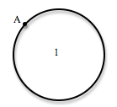
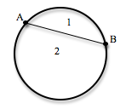
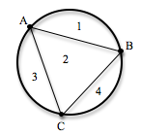
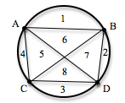
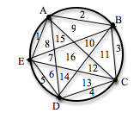
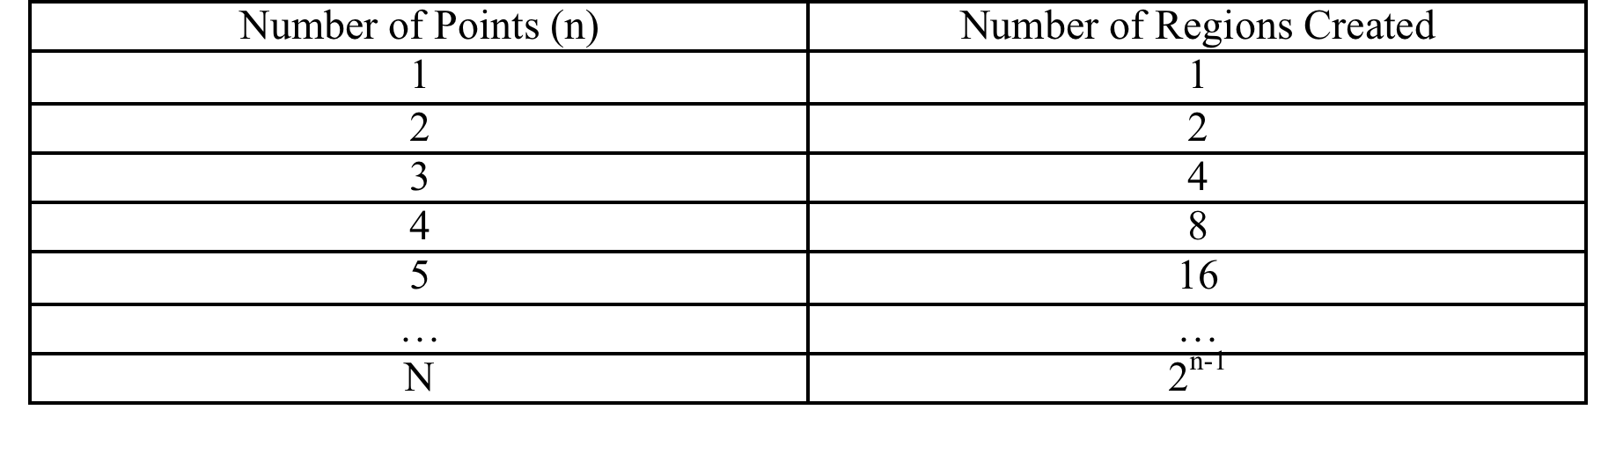
Sometimes Mathematics is Not So Predictable!!!
1
2
3
4
5
….
n
Notes:
51

Slide 52
Does the 6th Circle Have 32 Regions?
Patterns Can Surprise Us!
A
3
B
No—
it
has 31.
15
16
13
14
17
4
2
27
18
12
26
28
19
F
31
30
C
11
25
20
29
21
1
10
24
9
22
8
23
5
7
E
6
D
Notes:
52

Slide 53
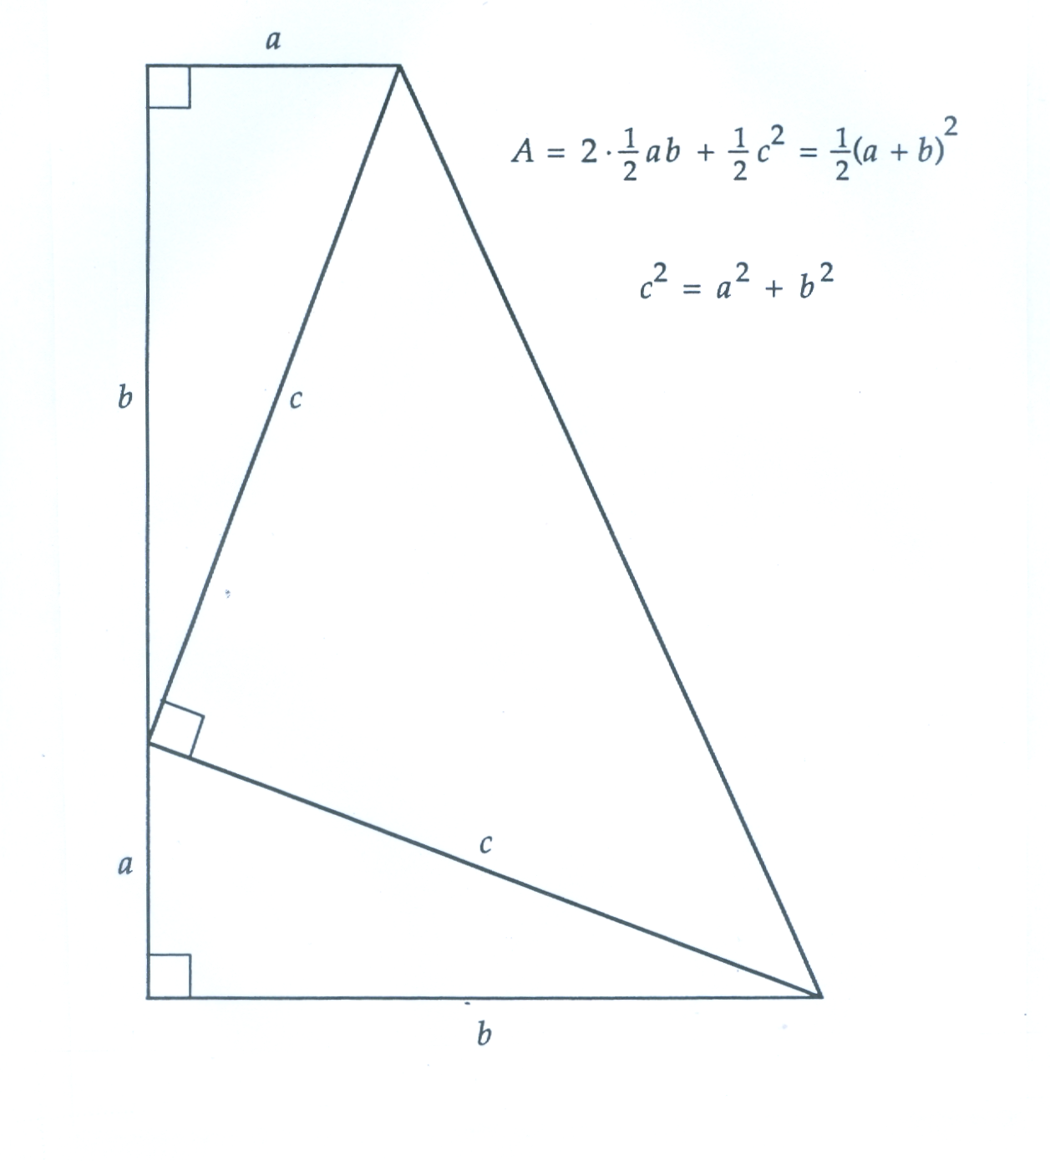
WithOut Words:
Excellent discovery activities, with or without verbal/algebraic hints! Great extra credit, take-home test bonus, etc.

Slide 54
You Can Make the WithOut Words Exercises into Your Own Guided Discovery Lessons!
A right triangle has legs a and b and hypotenuse c. We are going to look at a relationship between these three sides that holds for all right triangles.
1. A right triangle has legs 4 and 17. Find the area of the triangle.____________
2. A triangle has legs a and b. Express the area of the triangle in terms of a and b. ____________
3. In the picture on the right, find the area of
right triangle I. _____________
4. Find the area of right triangle II.______________
5. Find the area of right triangle III.___________
6. Eliminate the sides with length c in the picture. Since the quadrilateral has only one pair of parallel sides, the quadrilateral is a _________________.
7. To find the area of the quadrilateral, you can add the area of the three right triangles. Combine like terms and express this area in simplest form.
________________________________________

Slide 55
You Can Make the WithOut Words Exercises into Your Own Guided Discovery Lessons!
8. Express the measure of the height of the trapezoid on the right in terms of a and b._____________
9. What is the length of the larger base of the trapezoid?_______
10. What is the length of the smaller base of the trapezoid?______________
11. What is the area of the trapezoid expressed in terms of a and b?________________________________
12. Square the binomial (a + b) in your expression from question 11, and rewrite your answer to question 11 with the trinomial you found after multiplying (a + b) by (a + b).
___________________________________________
13. In question 7 above, you found the area of the same trapezoid by adding the areas of the three right triangles. Set that expression equal to your answer from question 12.
__________________________________
14. Multiply both sides of the equation by 2 to eliminate the fraction.
_______________________________________________________
15. Subtract 2ab from both sides. What is the new equation?______________________

Slide 56


Don’t Re-Invent the Wheel!
“Proofs Without Words” by Roger Nelsen
MAA.org
Notes:
.

Slide 57
Don’t Lose a Day!
Guided discovery lessons are perfect to have students move ahead even on days you are absent and have a non-math substitute!

Slide 58
Thank You
for attending this session!
If you have any questions or comments, please feel free to contact me at
dr.rsgroi@gmail.com

Slide 59

FINANCIAL APPLICATIONS:
REAL WORLD
REAL MATH
REAL INTEREST
Richard Sgroi, Ph.D.
dr.rsgroi@gmail.com
financialalgebra.com
TODAY 2:20 - 3:20 PM in EVERGREEN

